Slide 1

CLASS 4 CD-404 DATA SCIENCE ROLES AND ITS LIFE CYCLE UNIT I
DATA SCIENCE ROLES AND ITS LIFE CYCLE
Prof. Vineeta Shrivastava
Assistant Professor
Department of Computer Science & Engineering
LNCT-E, Bhopal
Lakshmi Narain College of Technology Excellence, Bhopal

Slide 2
CLASS 4 CD-404 DATA SCIENCE ROLES AND ITS LIFE CYCLE UNIT I
AGENDA
Roles of Data Science
Core Components of Data Science Roles
Data Scientist
Data Analyst
Machine Learning Engineer
Data Engineer
Business Intelligence (BI) Analyst
Statistician
Life cycle of DS
Prof. Vineeta Shrivastava
Assistant Professor
Department of Computer Science & Engineering
LNCT-E, Bhopal
Lakshmi Narain College of Technology Excellence, Bhopal

Slide 3
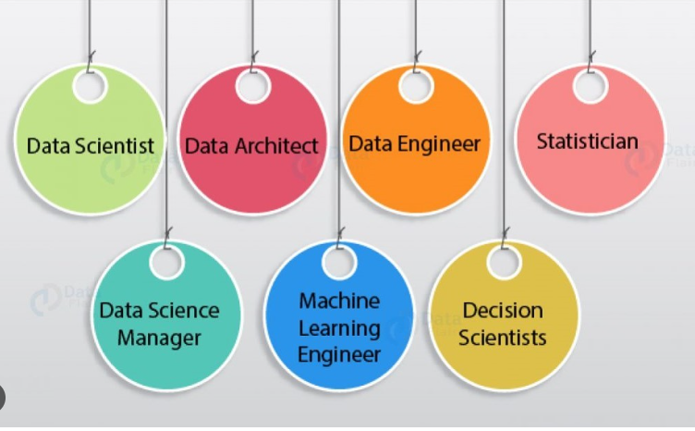
CLASS 4 CD-404 DATA SCIENCE ROLES AND ITS LIFE CYCLE UNIT I
Roles of Data Science
Prof. Vineeta Shrivastava
Assistant Professor
Department of Computer Science & Engineering
LNCT-E, Bhopal
Lakshmi Narain College of Technology Excellence, Bhopal

Slide 4
CLASS 4 CD-404 DATA SCIENCE ROLES AND ITS LIFE CYCLE UNIT I
Roles of Data Science
Data science encompasses a diverse set of roles, each playing a crucial part in the end-to-end process of extracting insights from data.
At the core is the Data Scientist, responsible for conducting Exploratory Data Analysis (EDA), building predictive models, and collaborating with domain experts to translate data into actionable insights.
Data Analysts focus on cleaning, transforming, and visualizing data, generating descriptive statistics, and supporting decision-making through data interpretation.
Prof. Vineeta Shrivastava
Assistant Professor
Department of Computer Science & Engineering
LNCT-E, Bhopal
Lakshmi Narain College of Technology Excellence, Bhopal

Slide 5
CLASS 4 CD-404 DATA SCIENCE ROLES AND ITS LIFE CYCLE UNIT I
Roles of Data Science
Machine Learning Engineers bring models to life, developing and deploying machine learning algorithms while optimizing for scalability.
Data Engineers design and maintain data architectures, ensuring data availability, consistency, and reliability through Extract, Transform, Load (ETL) processes.
Prof. Vineeta Shrivastava
Assistant Professor
Department of Computer Science & Engineering
LNCT-E, Bhopal
Lakshmi Narain College of Technology Excellence, Bhopal

Slide 6
CLASS 4 CD-404 DATA SCIENCE ROLES AND ITS LIFE CYCLE UNIT I
Roles of Data Science
Business Intelligence (BI) Analysts leverage data to create informative dashboards and reports, facilitating strategic decision-making within organizations.
Statisticians contribute their expertise in applying statistical methods to analyze data, conduct experiments, and shape study designs.
Prof. Vineeta Shrivastava
Assistant Professor
Department of Computer Science & Engineering
LNCT-E, Bhopal
Lakshmi Narain College of Technology Excellence, Bhopal

Slide 7
CLASS 4 CD-404 DATA SCIENCE ROLES AND ITS LIFE CYCLE UNIT I
Roles of Data Science
Each role demands a unique skill set, from programming and statistical knowledge to effective communication, highlighting the interdisciplinary nature of data science.
As the field continues to evolve, the integration of these roles remains pivotal in harnessing the power of data to drive innovation and informed decision-making across industries.
Prof. Vineeta Shrivastava
Assistant Professor
Department of Computer Science & Engineering
LNCT-E, Bhopal
Lakshmi Narain College of Technology Excellence, Bhopal

Slide 8
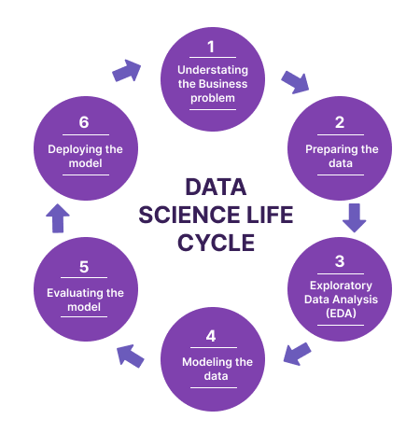
CLASS 4 CD-404 DATA SCIENCE ROLES AND ITS LIFE CYCLE UNIT I
Core Components of Data Science Roles
The core components of data science roles encompass a set of fundamental activities that collectively contribute to the process of extracting meaningful insights from data.
Data Collection
Data Cleaning
Exploratory Data Analysis (EDA)
Prof. Vineeta Shrivastava
Assistant Professor
Department of Computer Science & Engineering
LNCT-E, Bhopal
Lakshmi Narain College of Technology Excellence, Bhopal

Slide 9
CLASS 4 CD-404 DATA SCIENCE ROLES AND ITS LIFE CYCLE UNIT I
Core Components of Data Science Roles
Feature Engineering
Model Building
Model Evaluation
Deployment
Data Visualization
Communication
Continuous Learning and Adaptation
Prof. Vineeta Shrivastava
Assistant Professor
Department of Computer Science & Engineering
LNCT-E, Bhopal
Lakshmi Narain College of Technology Excellence, Bhopal

Slide 10

CLASS 4 CD-404 DATA SCIENCE ROLES AND ITS LIFE CYCLE UNIT I
Data Scientist
A data scientist is an analytics professional who is responsible for collecting, analyzing and interpreting data to help drive decision-making in an organization.
Prof. Vineeta Shrivastava
Assistant Professor
Department of Computer Science & Engineering
LNCT-E, Bhopal
Lakshmi Narain College of Technology Excellence, Bhopal

Slide 11
CLASS 4 CD-404 DATA SCIENCE ROLES AND ITS LIFE CYCLE UNIT I
Data Scientist
The data scientist role combines elements of several traditional and technical jobs, including mathematician, scientist, statistician and computer programmer.
It involves the use of advanced analytics techniques, such as machine learning and predictive modelling, along with the application of scientific principles.
Prof. Vineeta Shrivastava
Assistant Professor
Department of Computer Science & Engineering
LNCT-E, Bhopal
Lakshmi Narain College of Technology Excellence, Bhopal

Slide 12
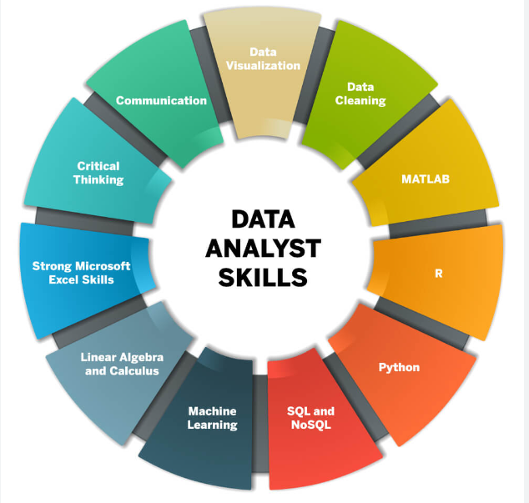
CLASS 4 CD-404 DATA SCIENCE ROLES AND ITS LIFE CYCLE UNIT I
Data Analyst
A data analyst collects, cleans, and interprets data sets to answer a question or solve a problem.
They work in many industries, including business, finance, criminal justice, science, medicine, and government.
Prof. Vineeta Shrivastava
Assistant Professor
Department of Computer Science & Engineering
LNCT-E, Bhopal
Lakshmi Narain College of Technology Excellence, Bhopal

Slide 13
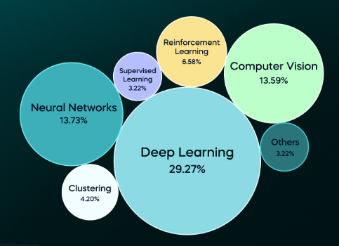
CLASS 4 CD-404 DATA SCIENCE ROLES AND ITS LIFE CYCLE UNIT I
Machine Learning Engineer
Machine learning engineers act as critical members of the data science team.
Their tasks involve researching, building, and designing the artificial intelligence responsible for machine learning and maintaining and improving existing artificial intelligence systems.
Prof. Vineeta Shrivastava
Assistant Professor
Department of Computer Science & Engineering
LNCT-E, Bhopal
Lakshmi Narain College of Technology Excellence, Bhopal

Slide 14
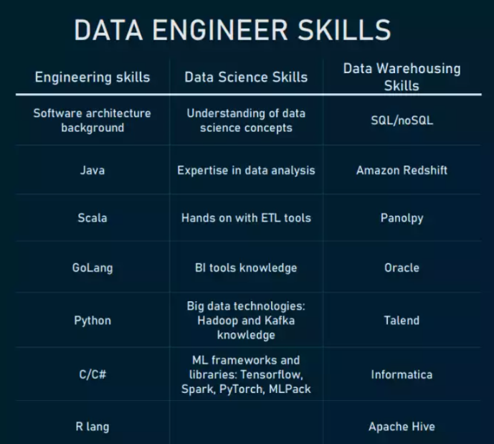
CLASS 4 CD-404 DATA SCIENCE ROLES AND ITS LIFE CYCLE UNIT I
Data Engineer
Data engineers work in various settings to build systems that collect, manage, and convert raw data into usable information for data scientists and business analysts to interpret.
Their ultimate goal is to make data accessible so that organisations can use it to evaluate and optimise their performance.
Prof. Vineeta Shrivastava
Assistant Professor
Department of Computer Science & Engineering
LNCT-E, Bhopal
Lakshmi Narain College of Technology Excellence, Bhopal

Slide 15
CLASS 4 CD-404 DATA SCIENCE ROLES AND ITS LIFE CYCLE UNIT I
Business Intelligence (BI) Analyst
A business intelligence (BI) analyst does just that by analyzing complex sets of data within a company to determine recommendations for business growth and improvement.
Knowing how to properly collect and interpret data can have a significant impact on a business' success.
Prof. Vineeta Shrivastava
Assistant Professor
Department of Computer Science & Engineering
LNCT-E, Bhopal
Lakshmi Narain College of Technology Excellence, Bhopal

Slide 16
CLASS 4 CD-404 DATA SCIENCE ROLES AND ITS LIFE CYCLE UNIT I
Statistician
Statisticians interpret data and communicate results to their clients, often with the aid of mathematical techniques and software.
In this role you'll ensure that complex statistical concepts are explained in a way the client can understand, and advise on strategy.
Prof. Vineeta Shrivastava
Assistant Professor
Department of Computer Science & Engineering
LNCT-E, Bhopal
Lakshmi Narain College of Technology Excellence, Bhopal

Slide 17
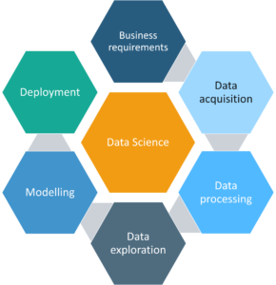
CLASS 4 CD-404 DATA SCIENCE ROLES AND ITS LIFE CYCLE UNIT I
Data Science Life Cycle
Prof. Vineeta Shrivastava
Assistant Professor
Department of Computer Science & Engineering
LNCT-E, Bhopal
Lakshmi Narain College of Technology Excellence, Bhopal

Slide 18
CLASS 4 CD-404 DATA SCIENCE ROLES AND ITS LIFE CYCLE UNIT I
Business requirements:-
What data do I need for my project?
What are the data sources?
How can I obtain the data?
What is the most efficient way to store and access all of it?
Prof. Vineeta Shrivastava
Assistant Professor
Department of Computer Science & Engineering
LNCT-E, Bhopal
Lakshmi Narain College of Technology Excellence, Bhopal

Slide 19
CLASS 4 CD-404 DATA SCIENCE ROLES AND ITS LIFE CYCLE UNIT I
Data Acquisition:-Now you found the objectives of the project now its time to start gathering the data.so data mining is the process of gathering your data from different sources.
Data Processing
Transform data into desired format
Data Cleaning
Missing values
Corrupted data
Remove unnecessary data.
Prof. Vineeta Shrivastava
Assistant Professor
Department of Computer Science & Engineering
LNCT-E, Bhopal
Lakshmi Narain College of Technology Excellence, Bhopal

Slide 20
CLASS 4 CD-404 DATA SCIENCE ROLES AND ITS LIFE CYCLE UNIT I
Data Exploration:-
Understand the patterns in the data
Retrieve useful insight
Form hypotheses
So now that you have sparkling clean set of data, you are finally ready to get started with your analysis.
Prof. Vineeta Shrivastava
Assistant Professor
Department of Computer Science & Engineering
LNCT-E, Bhopal
Lakshmi Narain College of Technology Excellence, Bhopal

Slide 21
CLASS 4 CD-404 DATA SCIENCE ROLES AND ITS LIFE CYCLE UNIT I
Data Exploration:-
The data exploration stage is basically the brainstorming of data analysis so in order to understand the patterns in your data you can use histogram or you can even create interactive visualizations.
This time you try to explore the different models that can be applied your data .
Prof. Vineeta Shrivastava
Assistant Professor
Department of Computer Science & Engineering
LNCT-E, Bhopal
Lakshmi Narain College of Technology Excellence, Bhopal

Slide 22
CLASS 4 CD-404 DATA SCIENCE ROLES AND ITS LIFE CYCLE UNIT I
Modelling:-
Determine optimal data features for the machine learning model.
Create a model that predicts the target most accurately
Evaluate and test the efficiency of the model.
Prof. Vineeta Shrivastava
Assistant Professor
Department of Computer Science & Engineering
LNCT-E, Bhopal
Lakshmi Narain College of Technology Excellence, Bhopal

Slide 23
CLASS 4 CD-404 DATA SCIENCE ROLES AND ITS LIFE CYCLE UNIT I
Deployment:-
Check the deployment environment for dependency issue.
Deploy the model in a pre production/test environment
Monitor the performance.
A goal of this stage is to deploy the model into a production or maybe a production like environment.
This is basically done for final user acceptance and the users have to validate the performance of the models and if there are any issues with the model or any issue with the algorithms then they have to be fixed in this stage.
Prof. Vineeta Shrivastava
Assistant Professor
Department of Computer Science & Engineering
LNCT-E, Bhopal
Lakshmi Narain College of Technology Excellence, Bhopal

Slide 24
CLASS 4 CD-404 DATA SCIENCE ROLES AND ITS LIFE CYCLE UNIT I
THANKYOU
Prof. Vineeta Shrivastava
Assistant Professor
Department of Computer Science & Engineering
LNCT-E, Bhopal
Lakshmi Narain College of Technology Excellence, Bhopal

